Slide 1
Hindi Handwriting synthesis using generative methods
An NLP presentation By
Abhishek Sinha
Aditi Dhavale
Amrut Ghadge
Dev Bhanushali
Harsh Kotadiya
22070126005
22070126006
22070126007
22070126032
22070126040
Source Code: https://github.com/devilb2103/Original-Gans-Paper-Implementation/tree/main/Pix2Pix
https://huggingface.co/devilb2103/Pix2Pix-Hindi-Text2HT/tree/main
Demo: https://drive.google.com/file/d/1JOWf5K7haTJmulqaCfpXRIzZ8oJZoZGf/view?usp=sharing

Slide 2

Problem Statement
The problem at hand is to Develop a tool that converts typed Hindi text into realistic handwriting, enabling users to generate handwritten documents and notes for digital use.

Slide 3
Applications
Handwriting Refining: Rewriting/Refining the digitally handwritten text. Just like apple notes.
Educational Tools: The generator can be used in educational software and applications to teach Hindi handwriting to students, providing customized examples and exercises.
Personalized Documents: Users and Businesses can generate handwritten notes, invitations, banners and letters in Hindi, adding a personal touch to digital documents.

Slide 4
Objectives
Generation of Hindi word dataset Using the CALAM Dataset
Deployment of mobile app which generates Hindi handwritten text
To Develop a model that generates handwritten Hindi words from typed Hindi text inputs and evaluating quality of synthesised text using HTR Methods

Slide 5
Software Requirements
Core NLP
WMAD Deployment
cv2
PyTorch
Tensorflow
Flutter
Quart (Asynchronous web app framework
built upon Flask)
Pytorch

Slide 6
Hardware Requirements
Core NLP
WMAD Deployment
2 x T4 GPU (2 x 16GB VRAM)
Intel(R) Xeon(R) CPU @ 2.20GHz
4 Cores 8 Threads
16GB RAM
(Kaggle Specs)
Intel i9 - 13980 HX @ 5.6GHz 24 Cores 32 Threads
NVIDIA RTX 4090 - 16GB VRAM
32GB DDR5 5600 MHZ Ram

Slide 7
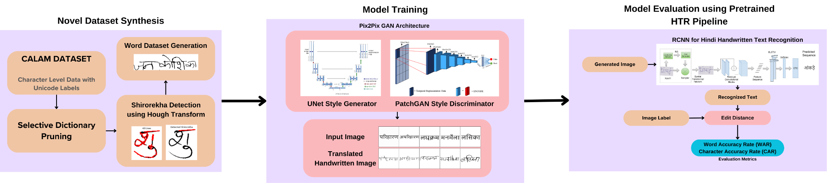
Methodology

Slide 8
Data Description and Preprocessing

Slide 9
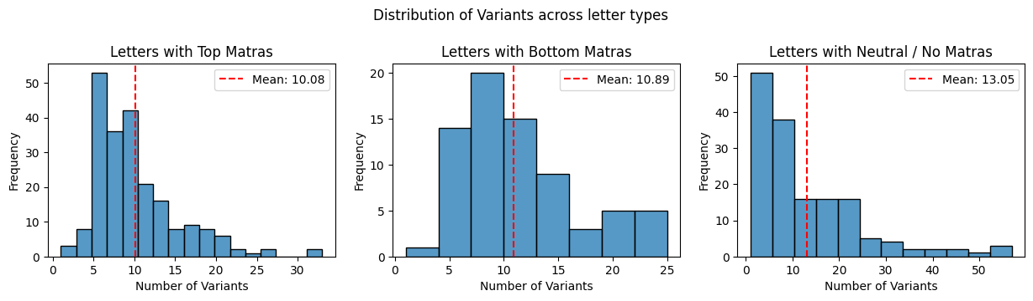
Dataset Description: CALAM Dataset
A total of 5007 letter images
445 unique letter combinations (includes matras and halants)
2187 Image samples with top Matras
784 Image samples with bottom Matras
2036 Image samples with neutral Matras

Slide 10
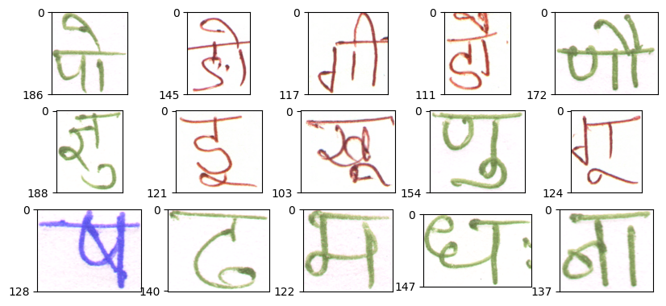
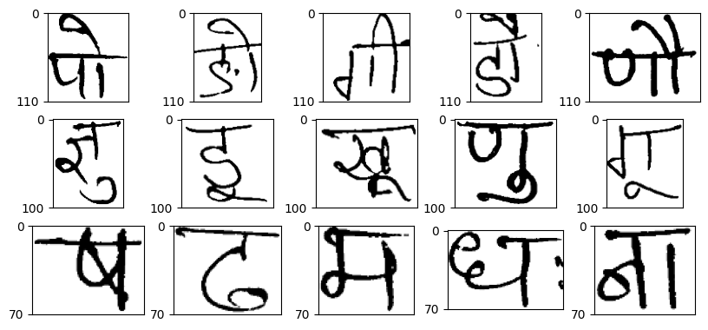
Hindi Letters dataset Before preprocessing
Hindi Letters dataset After binarising & resizing
A total of 5007 letter images, 445 unique letter combinations
Dimensions of letter types:
Letters with upper matra: 110
Letters with lower matra: 100
Letters with no/side matra: 70

Slide 11
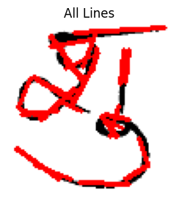
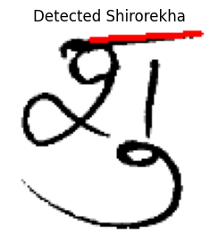
Shirorekha Detection
Hough Line Transform[2] is used to extract shirorekha from image, robust to short, curved and tilted shirorekha.
If the letter has upper matra, shirorekha cannot lie in first 30 pixels of the image.
Shirorekha cannot lie in bottom half of the image.
Shirorekha may be tilted in the range of 80 degrees to 100 degrees.
Lines are sorted by their length (decreasing order) and then by their y-axis positions (increasing order)
Total 5007 images of all characters and its variants reduced to 4725 images (5.5% data loss due to lack of shirorekha in some letters).

Slide 12
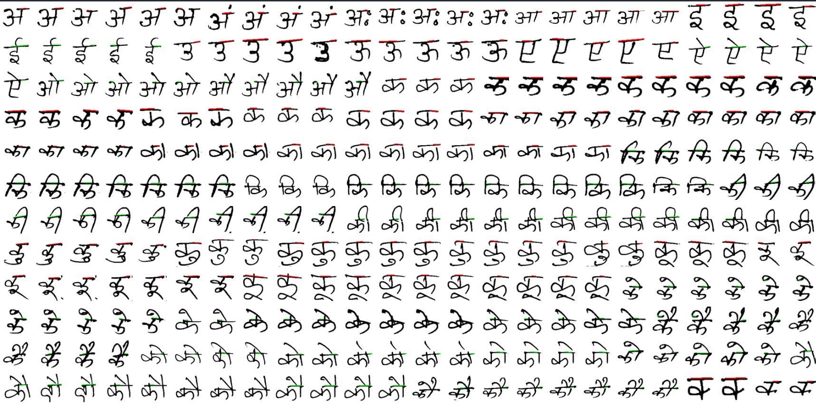
Shirorekha Detection

Slide 13
Evaluating our Word Corpus
Used a hindi dictionary[3] originally containing 4.75 lakh words as a reference to generate our word images.
Implemented an algorithm to filter and remove words from the dictionary that use letters outside of our dataset.
Final size of the reference word corpus ≈ 205000.

Slide 14
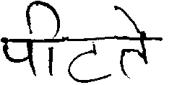
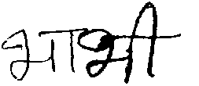
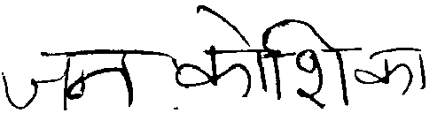
Word Sample Generation
Letters are concatenated to each other from left to right using the bitwise OR operation.
Start point of Shirorekha of the next letter is at the end height of the shirorekha of the previous letter.
All consecutive letters overlap 15% of the previous letter.
Approximately 2,00,000 samples generated.
Sample count can be easily inflated to 20,00,000 - 30,00,000 due to large number of letter variants available in the dataset.
पीटते
भाभी
जनकोशिका
Some sample generated words

Slide 15
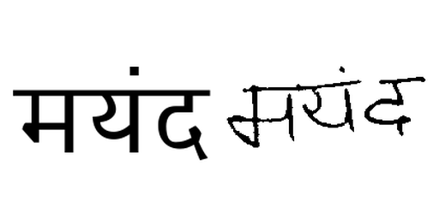
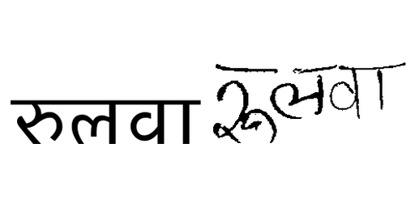
Final Dataset for Model Training
We also generated typed hindi words parallely to handwritten hindi words to make the training dataset for our Pix2Pix model.
Standard “Amiko-regular” font was used to create the typed hindi words.

Slide 16
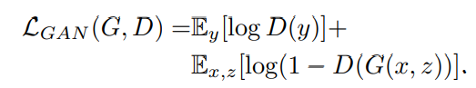
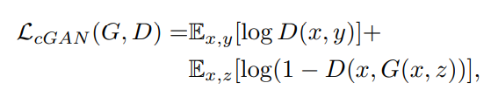
Pix2Pix Architecture
GAN Loss of Unconditional Variant (typically there is no context ‘x’ taken by generator G)
GAN Loss of conditional Variant
D(y) is the discriminator’s estimate that a real sample y is indeed real.
D(G(x,z)) is the discriminator's estimate that the generated sample G(x,z) is real.
Notes:
Generator’s Goal: The generator GGG creates fake data G(x,z)G(x, z)G(x,z) from random noise zzz (and possibly other conditioning inputs xxx). The generator’s goal is to make the discriminator believe that its generated samples are real. Therefore, the generator tries to minimize the discriminator’s ability to distinguish between real and fake data, i.e., it wants the discriminator to incorrectly classify fake samples as real.
To do this, the generator aims to maximize D(G(x,z))D(G(x, z))D(G(x,z)), the probability that the discriminator classifies the generated data as real. Since the generator is trying to minimize the discriminator’s ability to distinguish fake from real, it tries to minimize log⁡(1−D(G(x,z)))\log(1 - D(G(x, z)))log(1−D(G(x,z))), which effectively makes the discriminator more likely to classify fake data as real.
Mathematically, the generator’s objective is to:
LG=−Ex,z[log⁡(D(G(x,z)))]\mathcal{L}_G = -\mathbb{E}_{x,z}[\log(D(G(x, z)))]LG​=−Ex,z​[log(D(G(x,z)))]
This pushes D(G(x,z))D(G(x, z))D(G(x,z)) closer to 1 (the value for real data).

Slide 17
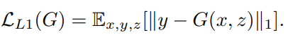
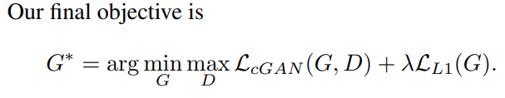
Pix2Pix Architecture
L1 Loss between actual image and generated image to encourage less blurring

Slide 18
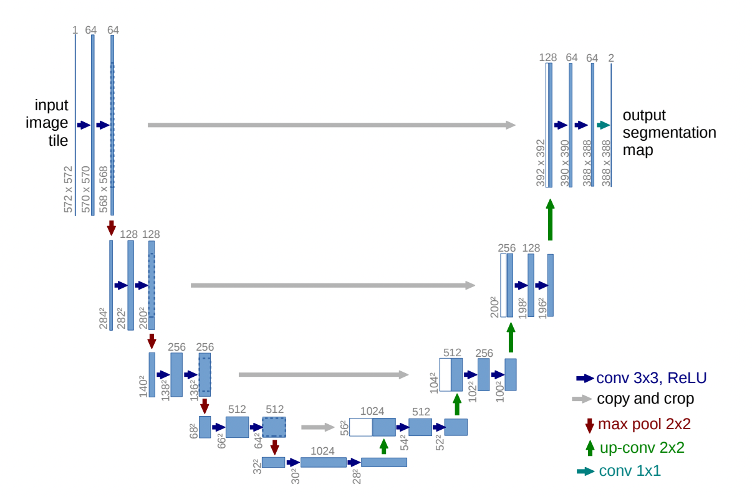
Pix2Pix Architecture
The Generator
Skip connections help preserve fine details that would otherwise be lost if only the bottleneck feature was to be upsampled.
Provides Alternate paths for gradients to flow leading to relatively faster training times.
Notes:
Encoder part - what is in the image
Decoder part - spatial information

Slide 19
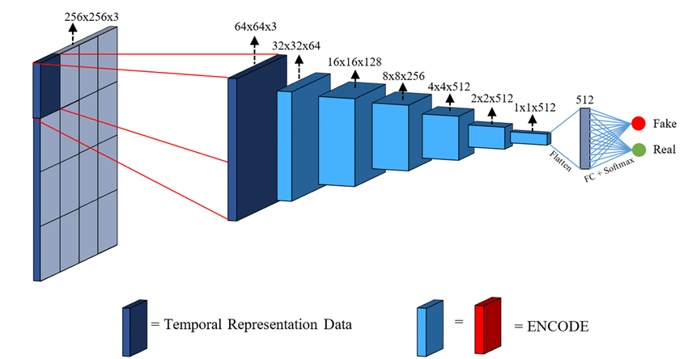
Pix2Pix Architecture
The Discriminator
Notes:
Both generator and discriminator use conv - batchnorm - leakyrelu

Slide 20
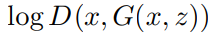
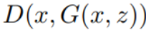
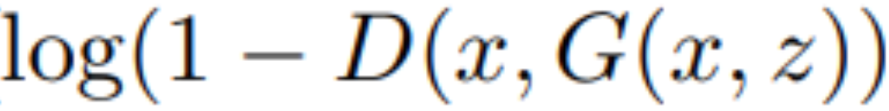
Pix2Pix Architecture
Standard Optimizations
When Discriminator D is confident in classifying Real images as real and generated images as fake, then generator G gets very weak feedback when training, leading to slow or no learning.
So, will turn out to be 0 and will be close to 0.
Using leads to stronger gradients when computing derivatives.
Notes:
Both generator and discriminator use conv - batchnorm - leakyrelu

Slide 21

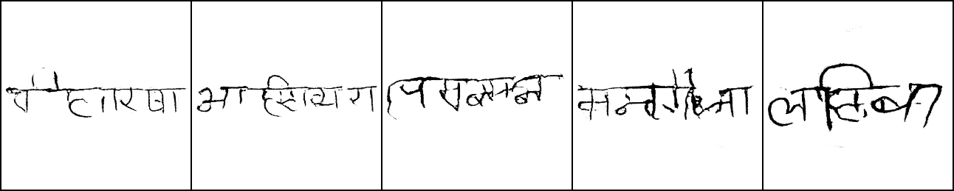
Generated Image Results
Trained on 20K Images
Test on 100K Images
60 Epochs
≈ 90 Hours of Training
Input
Generated

Slide 22
Evaluation using HTR Model
We use Levenshtein Distance to compute Character Accuracy rate (CAR) and Word Accuracy Rate (WAR) between ground truth labels and recognized text.
Example:
Kitten vs sitting
Step 1 - Substitution (k → s) - "kitten" → "sitten"
Step 2 - Substitution (e → i) - "sitten" → "sittin"
Step 3 - Insertion (g at the end) - "sittin" → "sitting"
2 Substitutions + 1 Insertions + 0 Deletions, Edit Distance = 3
CAR = 1 - (Edit Distance / No. Chars) = 1 - (3/6) = 0.5
WAR = 0

Slide 23
Evaluation using HTR Model
Results of CRNN on Real1K and Syn85K on benchmark handwritten Images
CAR: 71.65%
WAR: 25.89%
Results of CRNN on 100k generated images from Test set
CAR: 23.61%
WAR: 0.57%

Slide 24
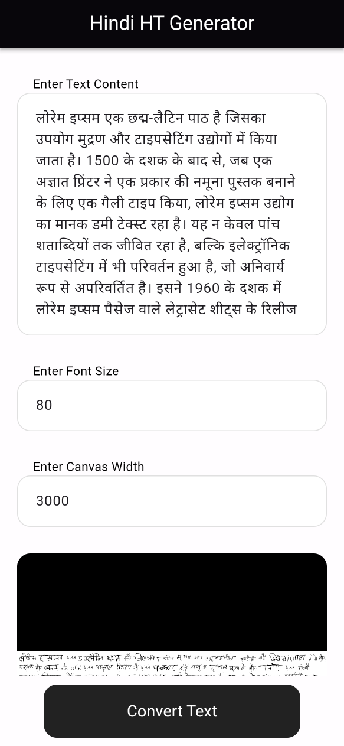
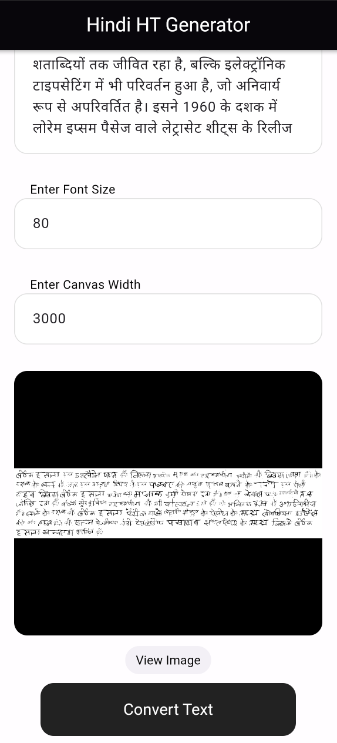
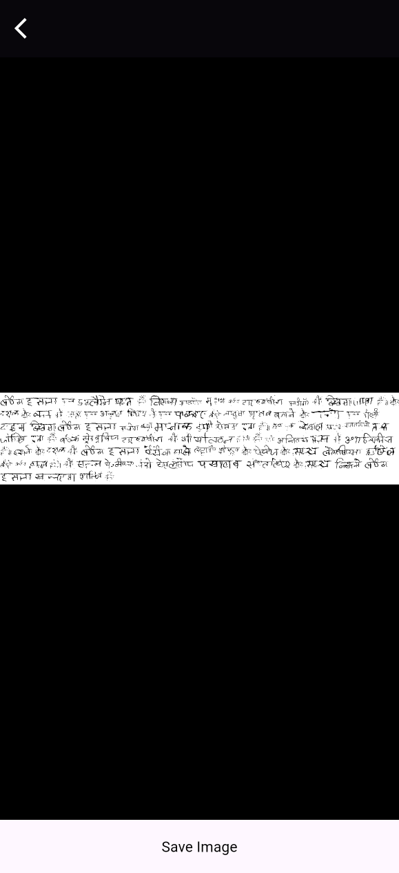
App Screenshots

Slide 25
References
[1] https://ieeexplore.ieee.org/document/9179634
[2] https://docs.opencv.org/3.4/d9/db0/tutorial_hough_lines.html
[3] https://github.com/eymenefealtun/all-words-in-all-languages/tree/main/Hindi

Slide 26
ThankYou

Slide 27
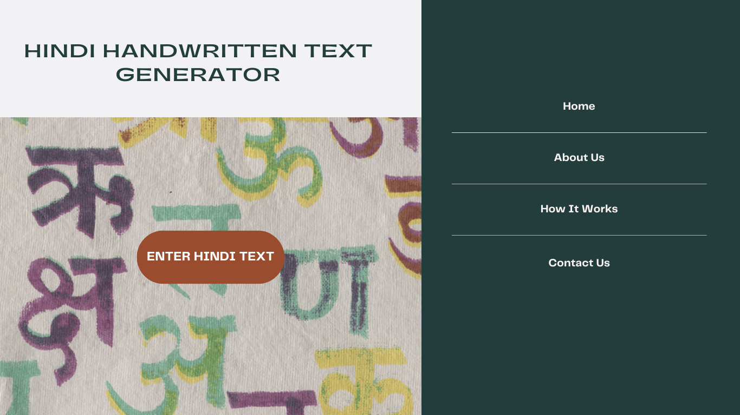
Website Layout - WMAD

Slide 28
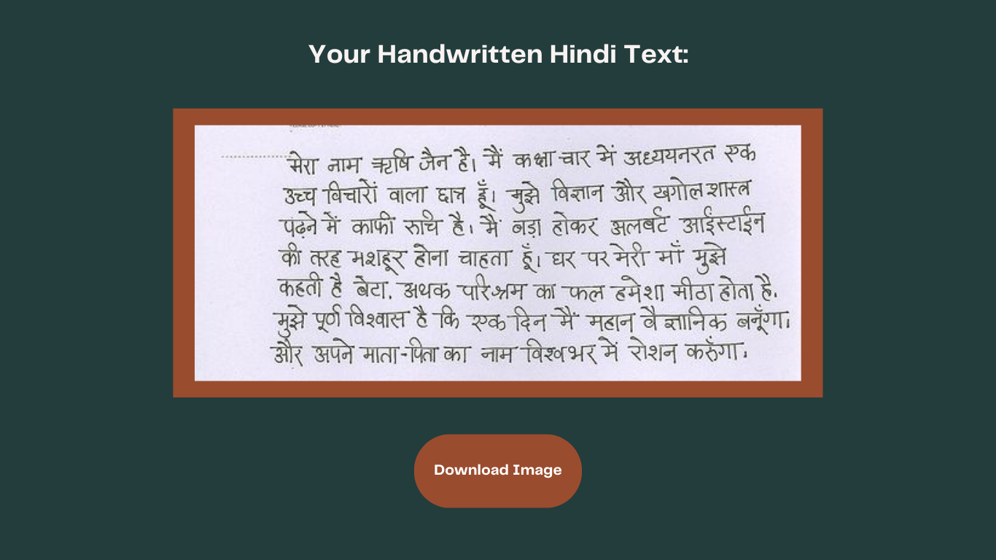
Website Layout - WMAD

Slide 29
Project Workflow
Binarizing of images, resizing letters, Shirorekha detection using Heuristic methods, data cleaning, concatenating letters to form words.
Considering models like: Vision Transformers, JokerGANs, CNN + RNN Architectures, etc.
The CALAM dataset was obtained after contacting the authors of reference paper[1]
2. Data preprocessing
Data Collection
3. Model Training
4. Generation & evaluation
5. Integration of Web Application
Generation of Hindi Handwritten Text, Evaluation can be done visually or using WER / CER using HTR Models, Fréchet inception distance for GANs
A simple handwritten text generator application. Model can be deployed on AWS Sagemaker. (free credits, yet to explore other methods)

